Slide 1

Title: Customer Segmentation Using Big Data in Retail
Analytics Group - 6
Members | Registration No.
Ankita Anand | 2024JULB00232
Sonali Agarwal | 2024JULB00155
Saraswati Gowda | 2024AUGVPGP0029
Subham Kumar Sahana | 2024JULB00161

Slide 2
Table of Contents
Introduction & Background
Problem Identification
Project Scope
Gap Analysis & Data Source
Data Analysis & Project Execution
Results & Insights
Prescriptive Strategy
Gap Closure
Industry Impact
Limitations & Future Scope

Slide 3
Industry Background – Deloitte
Rapid growth in credit card usage driven by digital payments and lifestyle spending.
Increase in consumer financing has expanded the market and customer base.
However, growth also increases credit exposure and default risk for banks.
Banks must balance revenue generation with responsible credit risk management.
Understanding customer spending and repayment behavior is now essential.
Data-driven segmentation helps maintain portfolio health and long-term profitability.

Slide 4
Problem Identification
Traditional credit card policies rely heavily on fixed rules and static risk scores.
This leads to:
One-size-fits-all credit limits, regardless of changing customer behavior.
Underestimation of hidden risk among high-utilization customers.
Missed revenue opportunities from safe and disciplined customers.
Increased probability of accounts turning into NPAs (Non-Performing Assets).
Thus, banks need behavior-based segmentation and dynamic credit limit management.

Slide 5
Project Objective
In Scope:
Customer Segmentation - Grouped customers based on spending and repayment behavior.
Predictive / Stress Analysis - Simulated economic stress to evaluate default sensitivity across segments.
Prescriptive Strategy Development - Formulated segment-wise credit limit and APR action rules for banks.
Out of Scope:
Real-time fraud detection or anomaly monitoring (covered under a different use case).
Customer churn or attrition prediction.
Deployment of predictive models in production environments.

Slide 6
Gap Analysis (AS-IS vs TO-BE)
Current (AS-IS) State | Proposed (TO-BE) Future State
Static credit limit assignments | Dynamic limit adjustments based on behavior
Risk detected after defaults occur | Risk predicted early through score indicators
Same treatment for all customer profiles | Personalized, segment-driven policy decisioning
Revenue growth conflicts with risk | Balanced growth via risk-adjusted strategies
Data Source
Dataset | Description | Key Fields
CC General Data | Monthly credit card usage & repayments | Balance, Purchases, Payments, Cash Advance
Demographics Data | Customer profile details | Income Tier, Age, City Category

Slide 7
Data Analysis Step 1:
Segmentation Framework
Segmentation was based on:
Utilization Ratio = Balance / Credit Limit
Repayment Discipline = % of Full Payments
Cash Advance Dependency
Segment | Characteristics | Risk Level
Safe High Spenders | Low utilization, strong repayment | Low Risk
Moderate Users | Balanced spending, average repayment | Medium Risk
Revolvers | High utilization, minimal full payments | High Risk
Over-Leveraged | Maxed-out usage & repayment stress | Very High Risk
Result of Segmentation:

Slide 8
Data Analysis Step 2:
Stress Testing
We tested how customer segments behave under economic stress conditions.
Stress Scenario:
+200 bps increase in interest cost
-15% reduction in repayment discipline
Segment’s Stress Table:
SEGMENT | BASE_RISK_SCORE | STRESSED_RISK_SCORE
Over-Leveraged | 0.983 | 1.001
Revolvers | 0.641 | 0.661
Moderate Users | 0.385 | 0.461
Safe High Spenders | 0.099 | 0.177
Findings:
Safe High Spenders → Remain financially stable.
Revolvers & Over-Leveraged → Show rapid increase in risk and likelihood of default.
Segment’s Resk Comparison
Segment | Base Risk Score | Stressed Risk Score | Interpretation
Over-Leveraged | Very High | Critical | Immediate intervention needed
Revolvers | High | Very High | Likely to default under stress
Moderate Users | Moderate | Moderate–High | Caution required
Safe High Spenders | Low | Low–Moderate | Stable even under stress
Impact:
Identifies vulnerable customer groups early, allowing the bank to take preventive actions before losses occur.

Slide 9
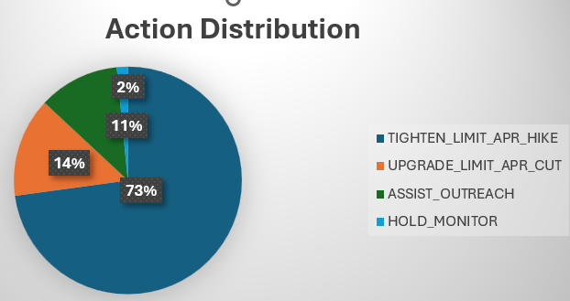
Data Analysis Step 3:
Prescriptive Strategy
Segment | Policy Action | Purpose
Safe High Spenders | Credit Limit Increase + APR Reduction | Promote loyalty & spending
Moderate Users | Hold & Monitor | Stabilize spending habits
Revolvers | APR Hike / Limit Cap | Prevent risky over-expansion
Over-Leveraged | Assist Outreach / Restructure Plan | Avoid default & reduce loss
ACTION_CODE | CUSTOMERS
TIGHTEN_LIMIT / APR_HIKE | 6519
UPGRADE_LIMIT / APR_CUT | 1263
ASSIST_OUTREACH | 1028
HOLD_MONITOR | 140

Slide 10
How Our Solution Fills the Gap
39.2% of customers now get personalised actions (31.3% reductions; 7.9% upgrades) vs 0% earlier.
Identifies hidden high-risk customers early.
Recognizes high-value, low-risk customers who should be rewarded.
Enables dynamic, controlled credit expansion instead of blanket increases.
Segmentation replaces one-size-fits-all: only 14.8% are “safe high spenders”; 85.2% need differentiated rules.

Slide 11
Industry Impact
Our model enables banks to:
Reduce failure and default probability.
Improve risk-adjusted ROI on credit portfolios.
Enhance customer satisfaction through personalized treatment.
Move from reactive to proactive credit management.
Strengthen long-term portfolio stability.

Slide 12
Limitations & Future Scope
Limitations:
Uses historical data only (no real-time behavioral updates).
Segmentation is static — customers may shift groups over time.
Stress scenario assumptions may not reflect all economic conditions.
Does not include external credit bureau data (CIBIL/Experian).
Model is not yet deployed into live decision systems.
Future Scope:
Enable real-time monitoring with streaming transaction data.
Dynamic segmentation that updates as customer behavior changes.
Integrate credit bureau & income verification APIs for higher accuracy.
Extend stress testing to multiple macro-economic scenarios.
Deploy as a decision support dashboard for credit risk teams.

Slide 13
THANK YOU

